Slide 1

STA130 Final Project
Qingwen Jia
q.jia@utoronto.ca
JIAQINGW
Vinson Liang
vinson.liang@mail.utoronto.ca
liang487
Choy Tsz Kiu
n.choy@mail.utoronto.ca
choytsz1
Joses Ng
josesyatnam.ng@utoronto.ca
ngjoses1
Jiale Qian
jiale.qian@utoronto.ca
qianji52

Slide 2
01
Introduction of Project
04
Final Model Creation
Model Performance Differentiation Prediction
02
05
Conclusion
03
Model Creation

Slide 3

Context
Goal
Introduction of the Project
A organization, UNICEF, is mean to save children's lives, to defend their rights, and to help them fulfil their potential, from early childhood through adolescence. Understanding the impact of societal conflict on communities is essential. Predictive modeling and data-driven approaches can play a significant role in identifying at-risk areas, optimizing response strategies, and facilitating more efficient resource utilization for mitigating the impact of conflict on societies globally.
This project seeks to provide insights and recommendations for improving predictive modeling outcomes, particularly in the context of UNICEF’s initiatives or responses, based on the findings derived from the analysis.

Slide 4
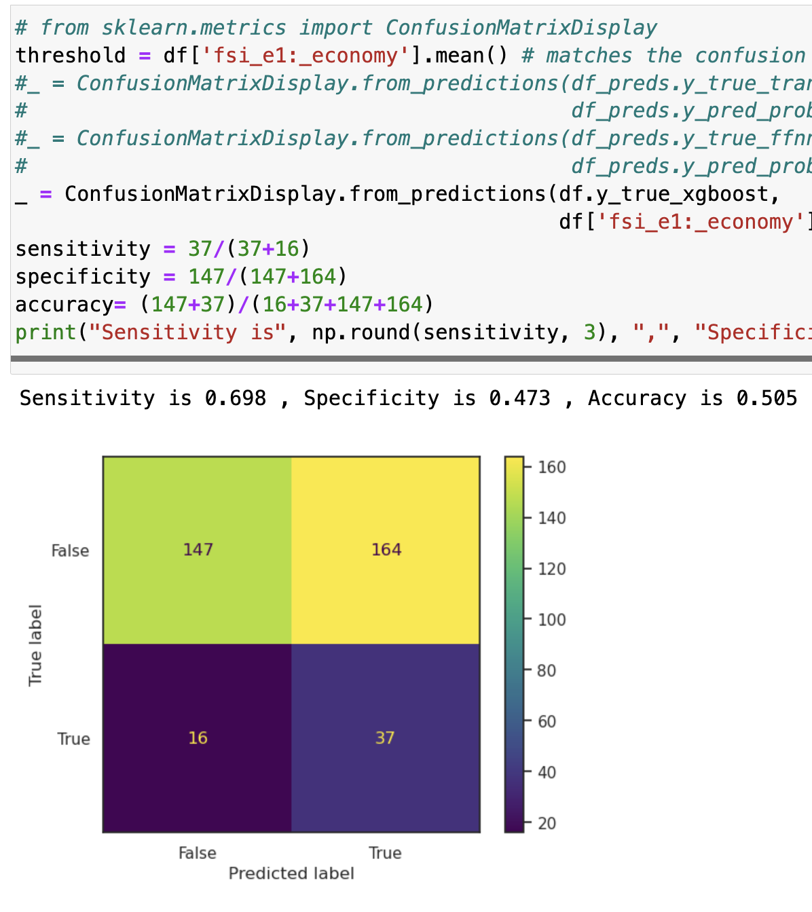
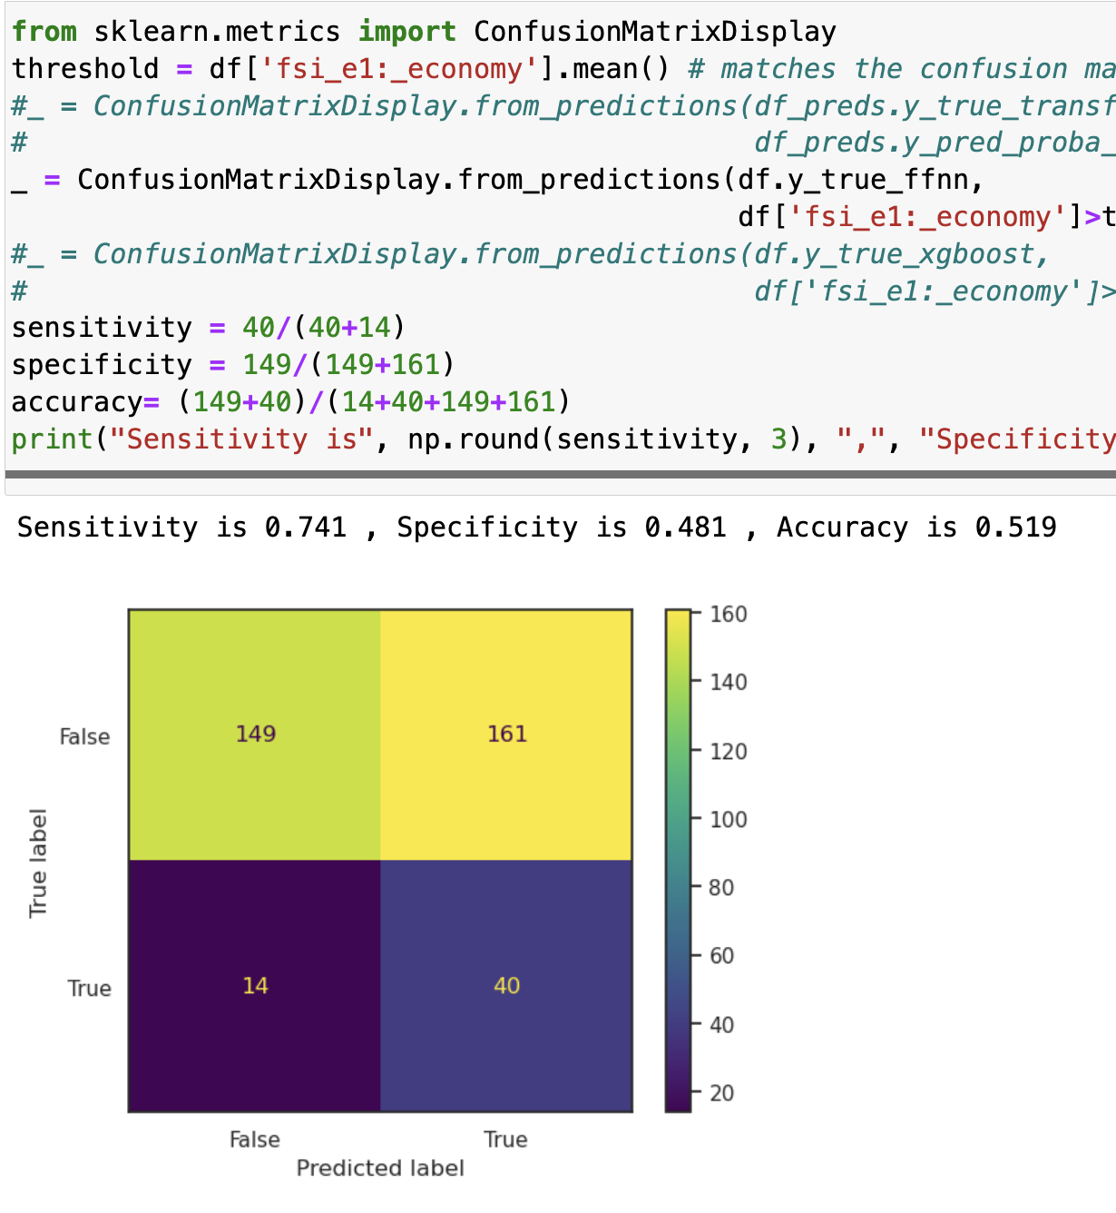
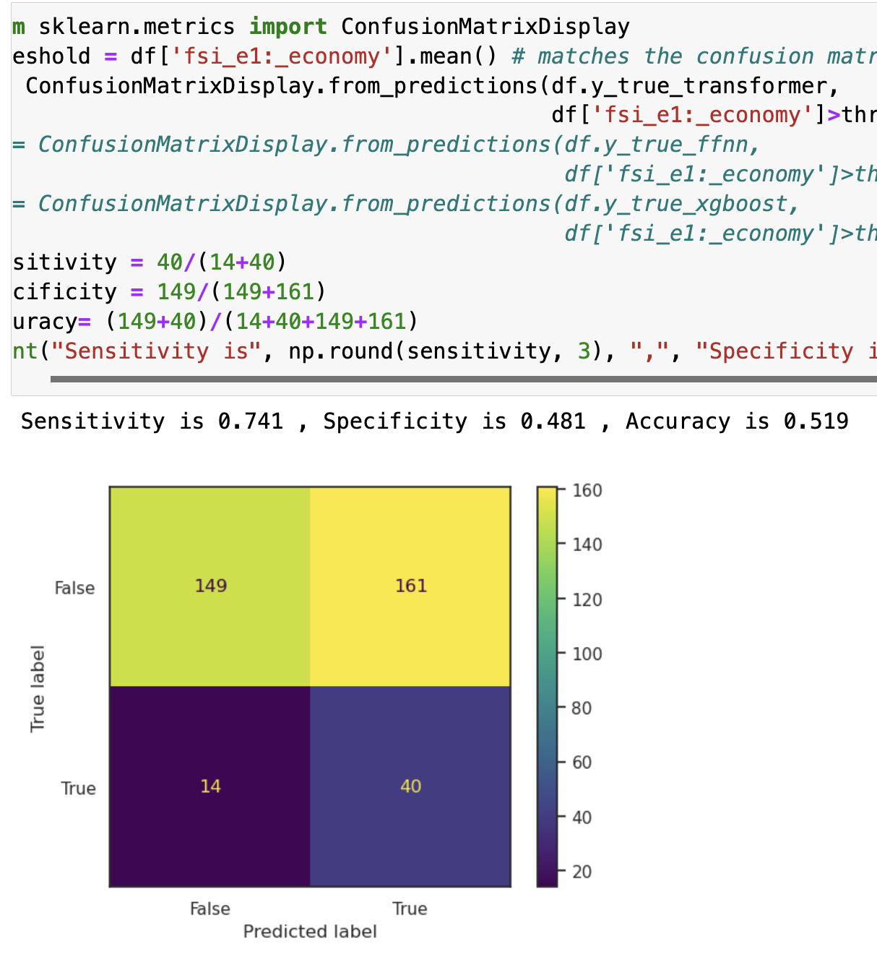
Model Performance Estimation by Metric
xgboost
ffnn
Transformer
Model Performance Differentiation Prediction

Slide 5
Model Performance Estimation by Metric Conclusion
In conclusion, the sensitivity of transformer is 0.741, the sensitivity of ffnn is 0.741 and the sensitivity of xgboost is 0.473. Compare the three models, transformer and ffnn has the same highest sensitivity and xgboost has the lowest sensitivity. We think transformer will have the better predictions for countries in terms of economy index.

Slide 6
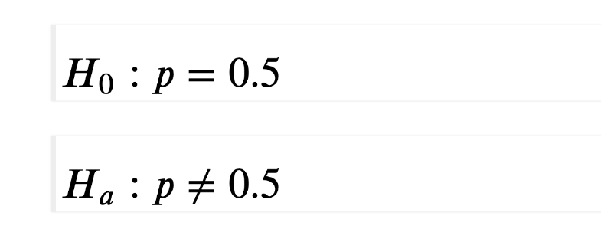
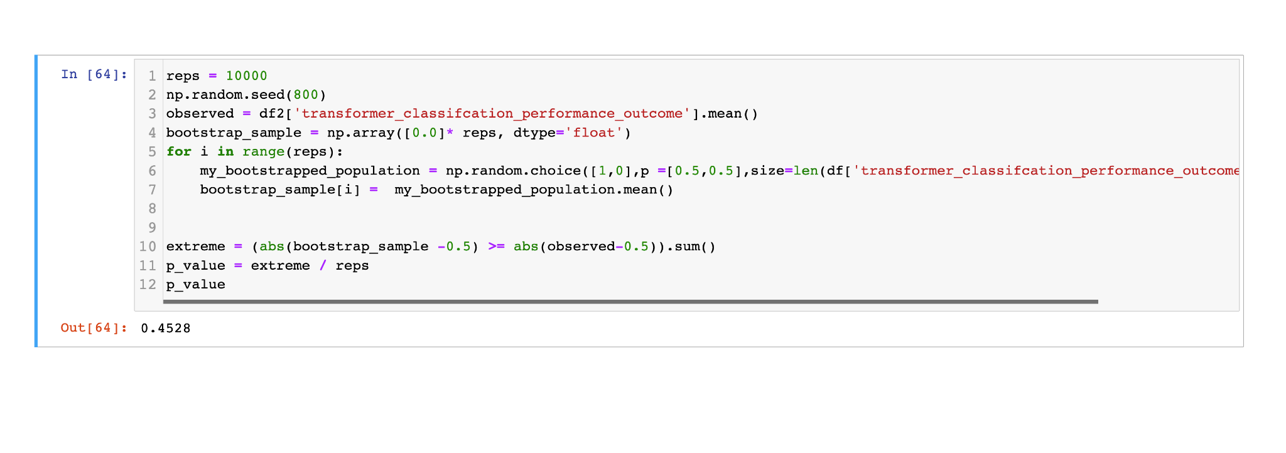
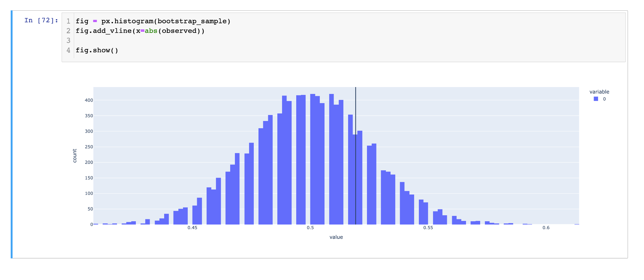
Different Model Comparison
Transformer Hypothesis Testing
Hypothesis Testing Conclusion
As the p-value is larger than 0.1, there is a very weak evidence against the null hypothesis of H0: p = 0.5, and we can't reject the null hypothesis. From this, we can say that the proportions of the correct prediction outcome is 0.5.

Slide 7
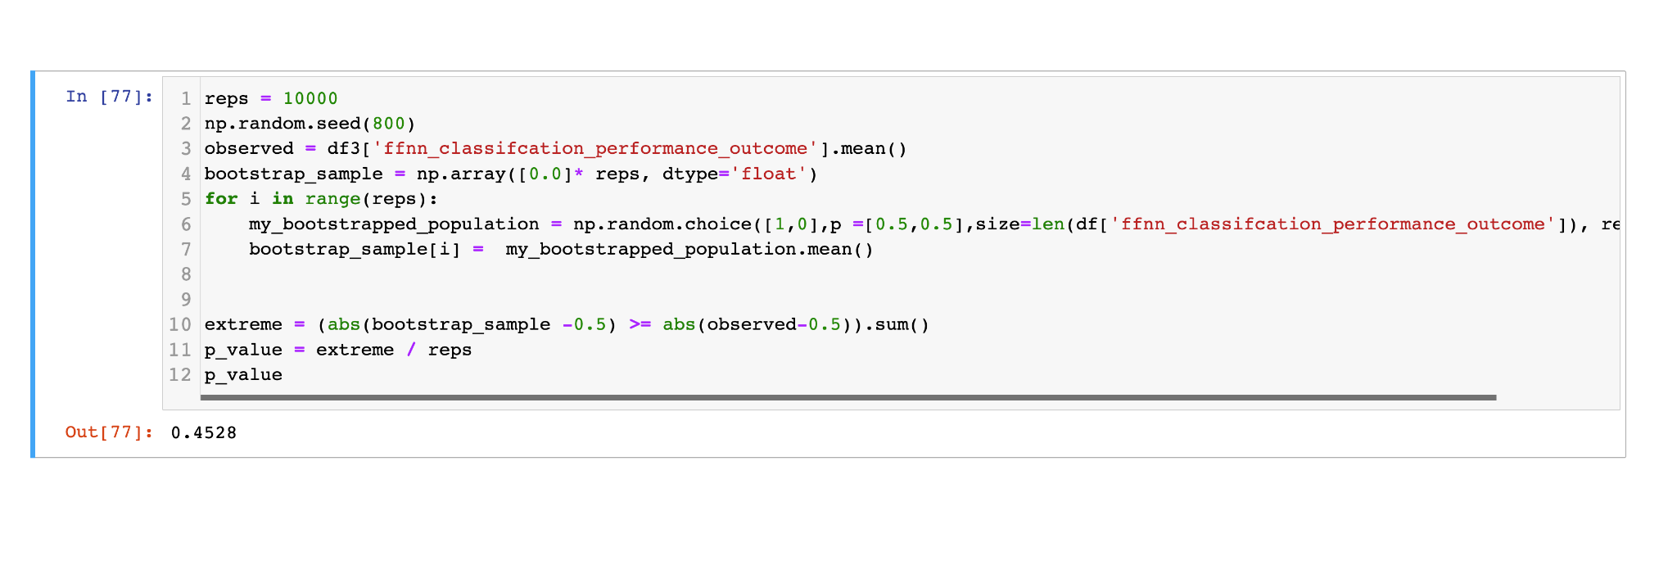
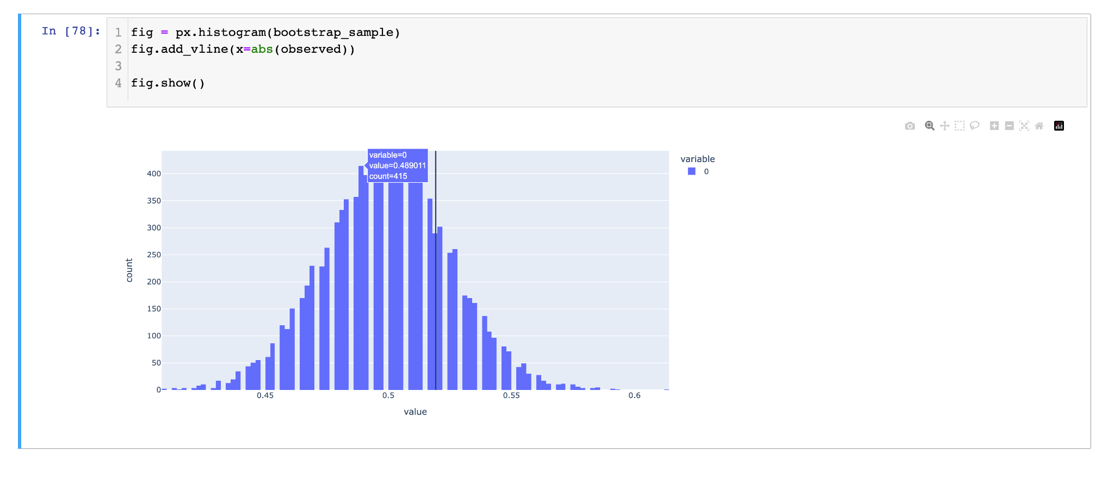
Different Model Comparison
ffnn Hypothesis Testing
Hypothesis Testing Conclusion
As the p-value is 0.4528 which is larger than 0.1, there is a very weak evidence against the null hypothesis of H0: p = 0.5, and we can't reject the null hypothesis. From this, we can say that the prooportions of the correct prediction outcome is 0.5.

Slide 8
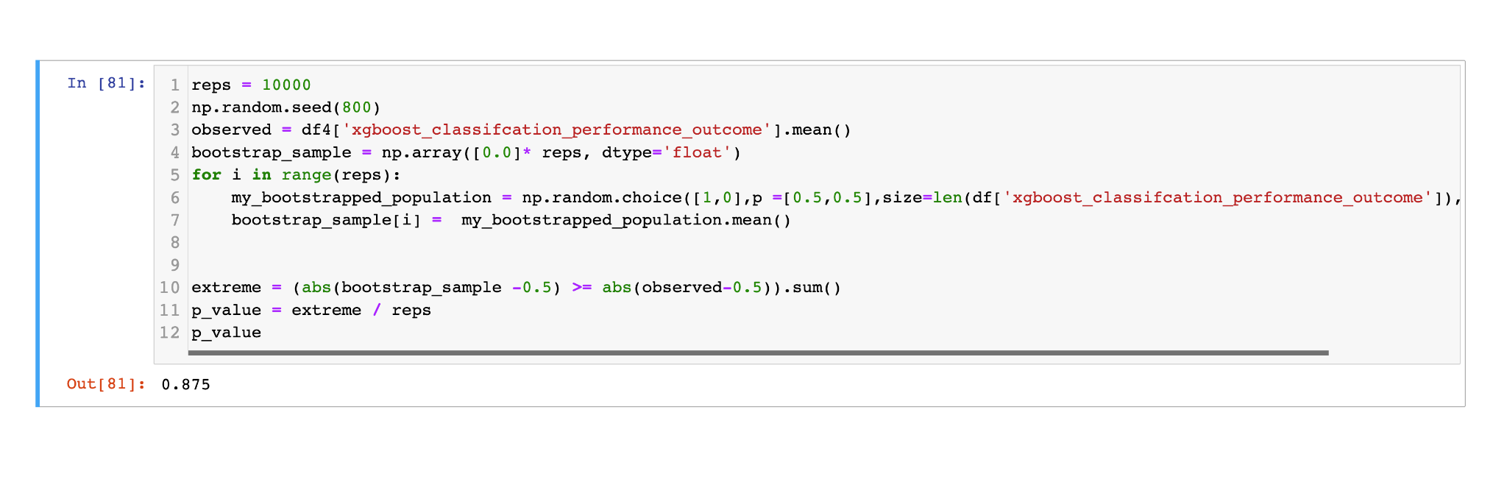
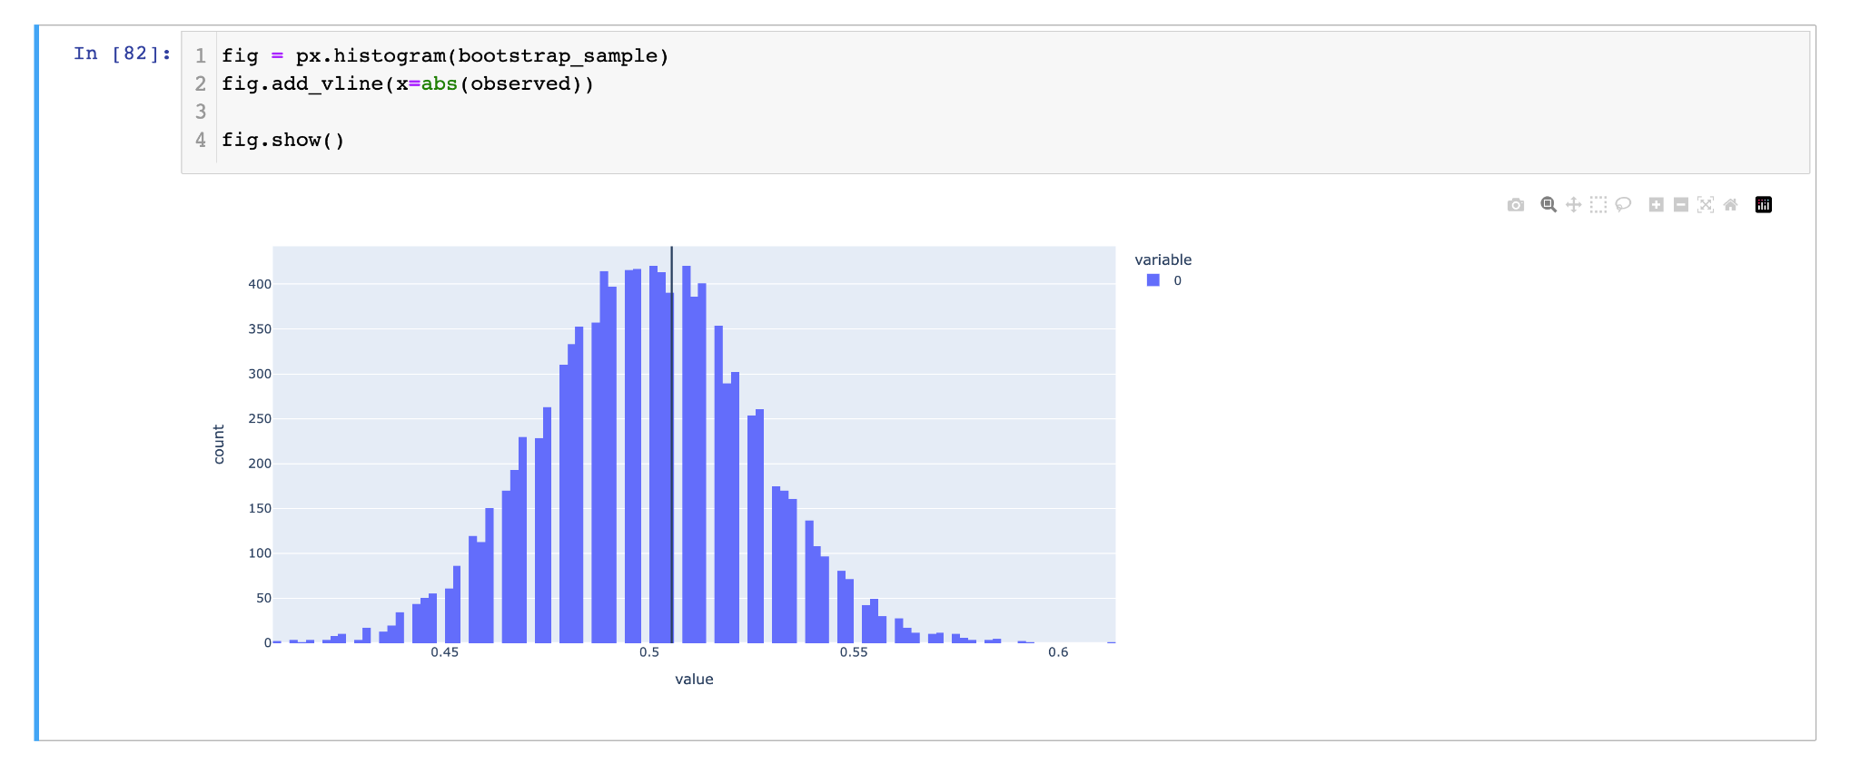
Different Model Comparison
xgboost Hypothesis Testing
Hypothesis Testing Conclusion
As the p-value is 0.875 which is larger than 0.1, there is a very weak evidence against the null hypothesis of H0: p = 0.5, and we can't reject the null hypothesis. From this, we can say that the proportions of the correct prediction outcome is 0.5.

Slide 9
Different Model Comparison Hypothesis Testing Conclusion
The p-value of transformer is 0.4528, the p-value of ffnn is 0.4528 and the p-value of xgboost is 0.875. In conclusion, xgboost has the highest p-value and transformer and ffnn has the same lower p-value. Thus, compare to the other two models in term of hypothesis testing whether the correct prediction is 50%, the transformer and ffnn has the best performance and xgboost have less performance.

Slide 10
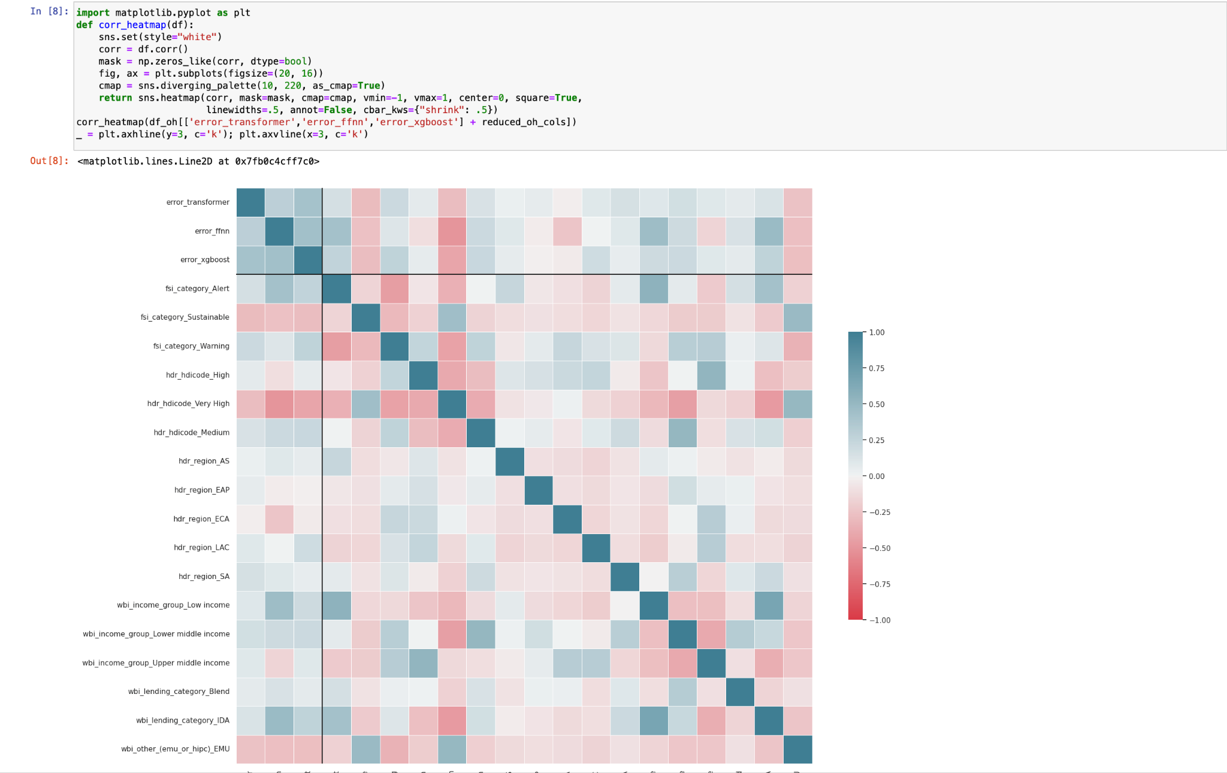
Model Creation
Correlation Matrix

Slide 11
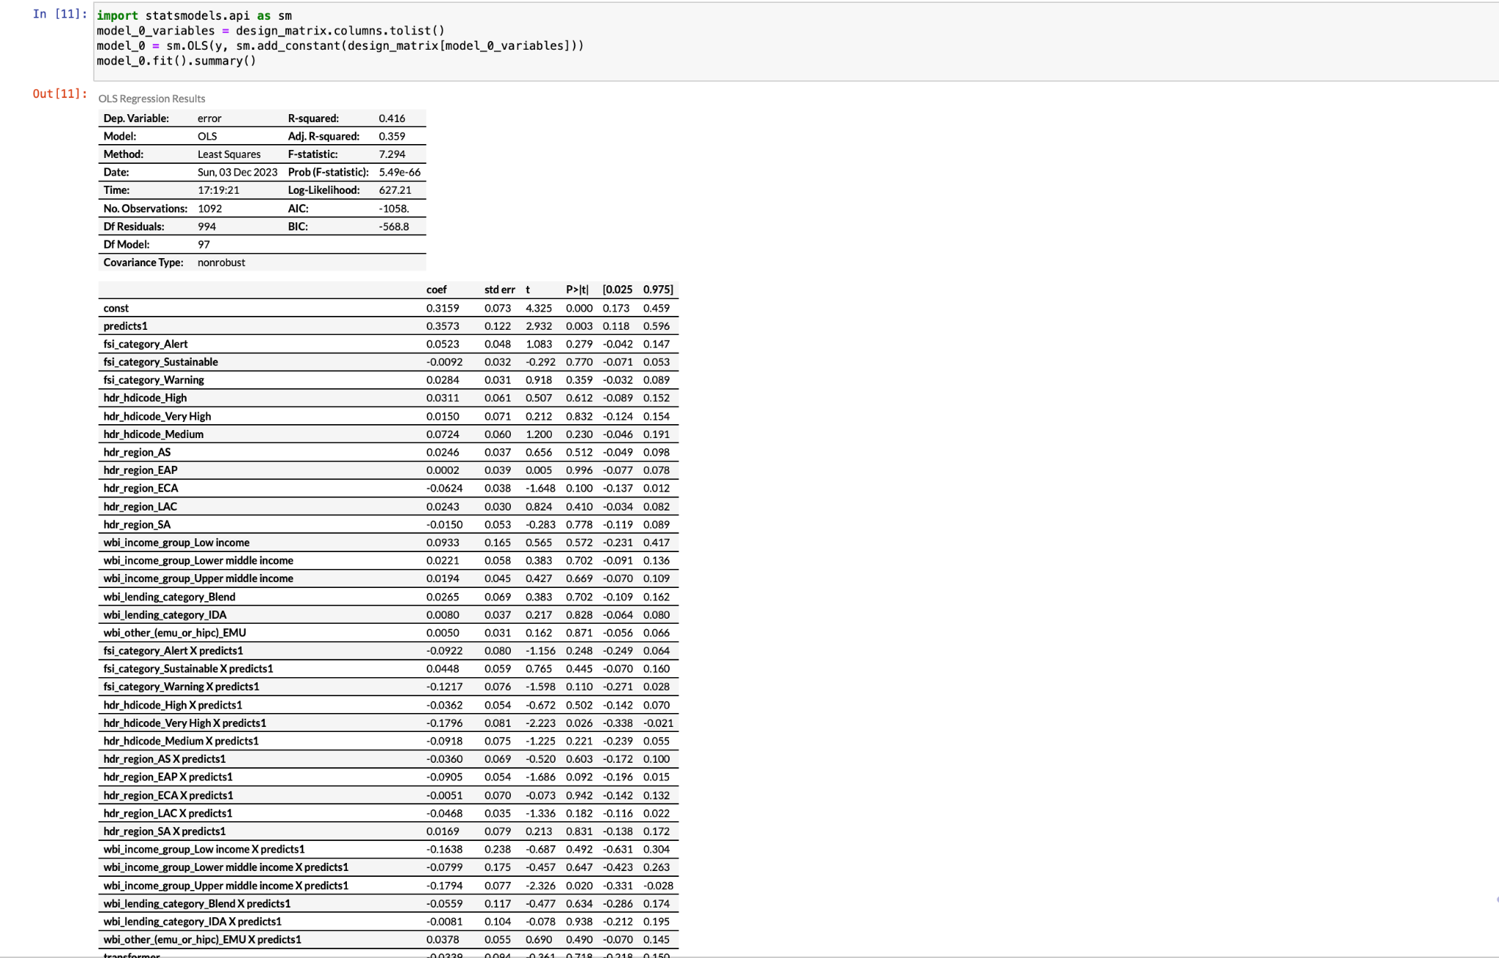
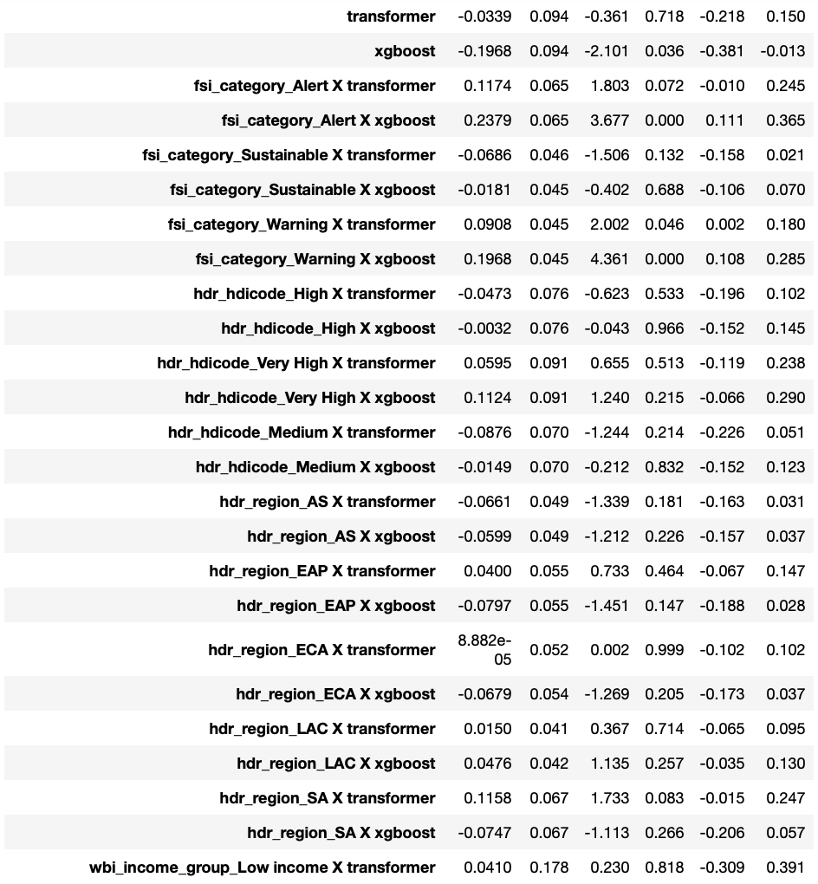
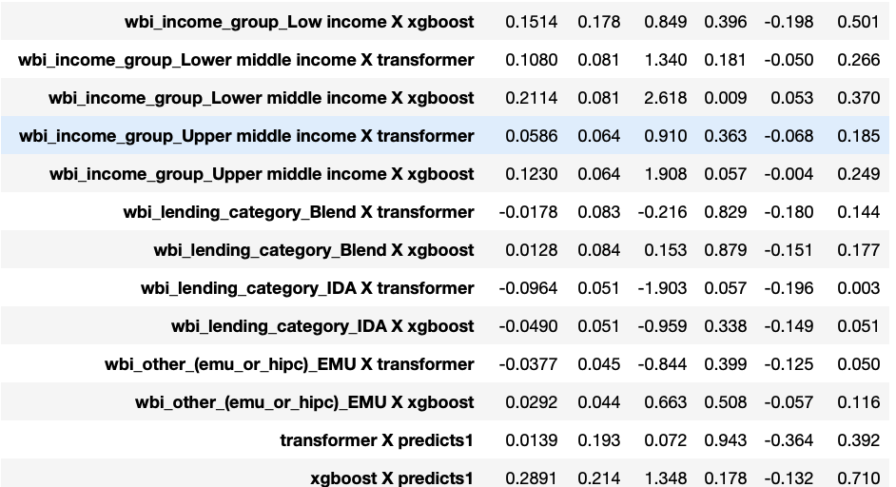
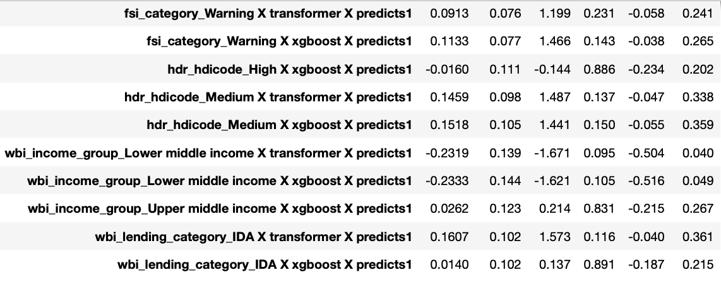
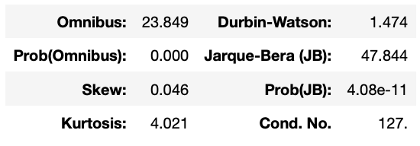
Model Creation
Model_0 (Over fitting)

Slide 12
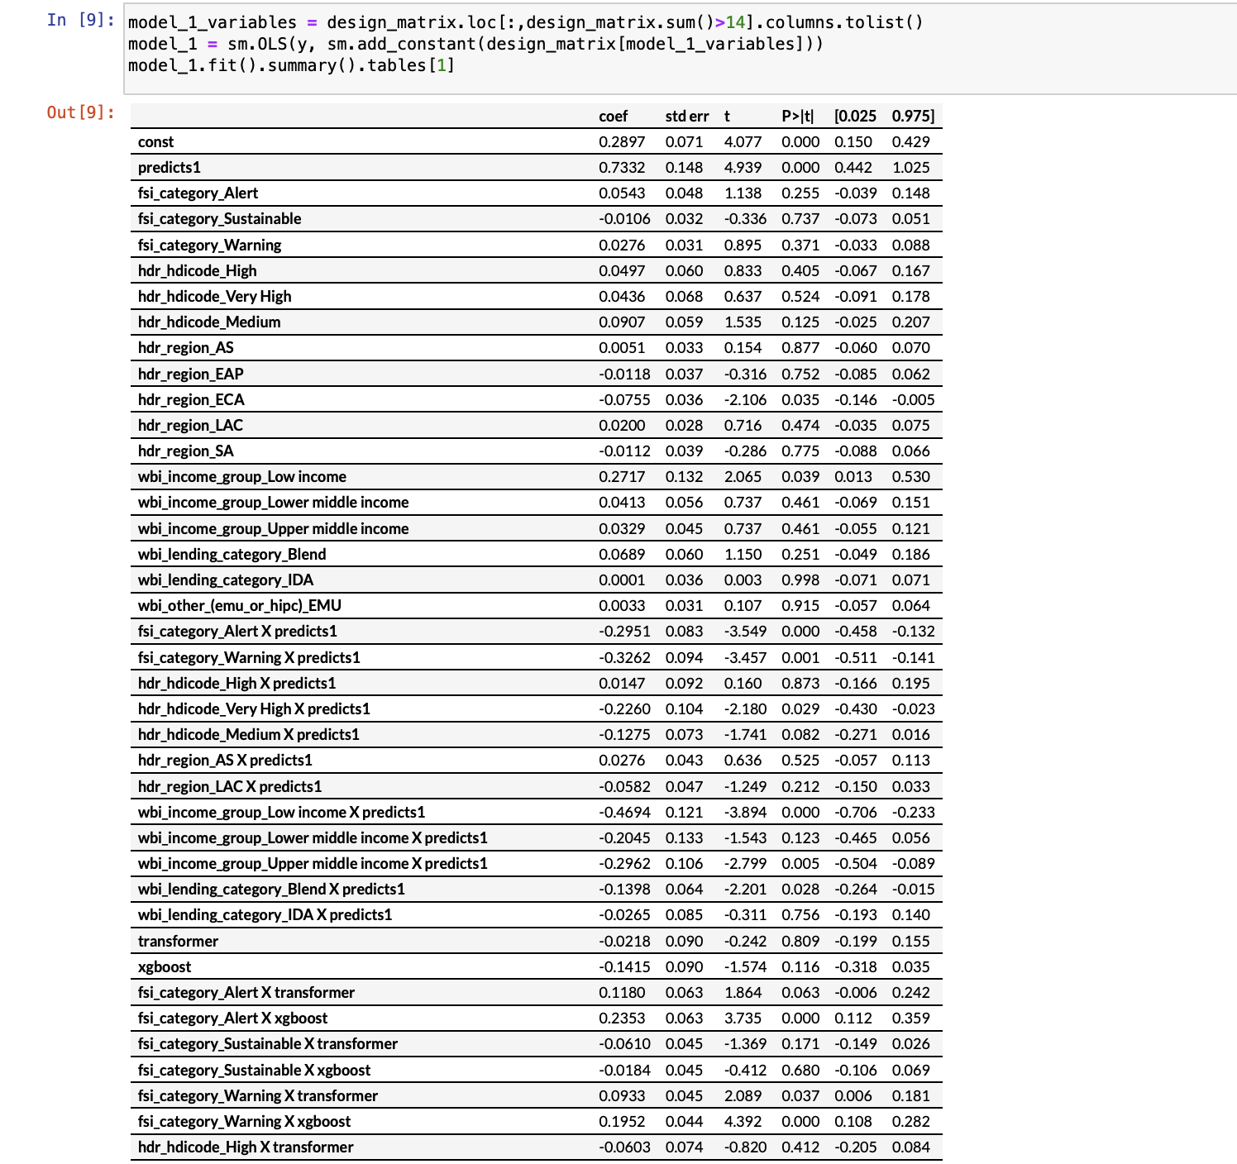
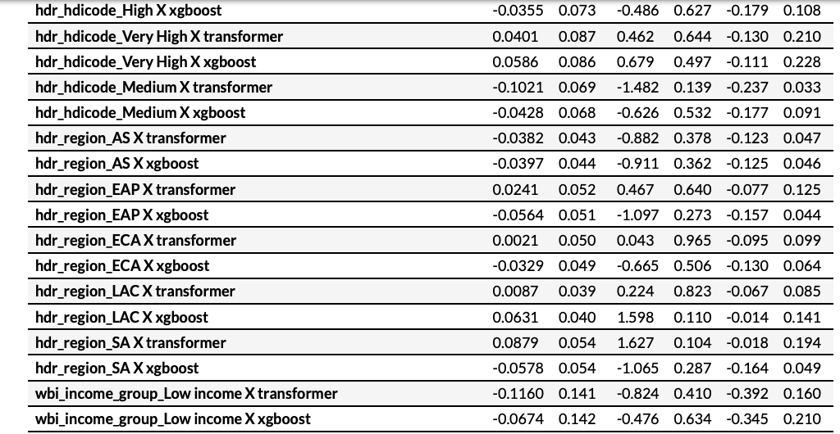
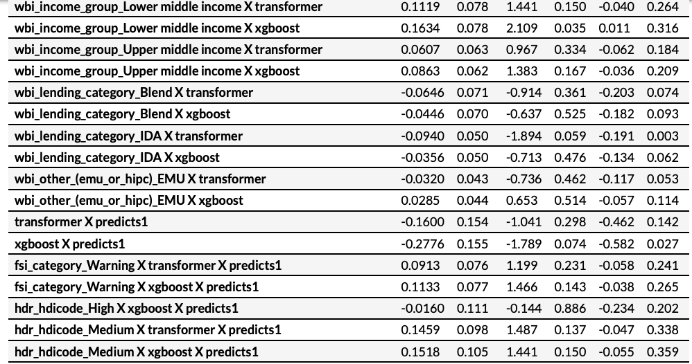
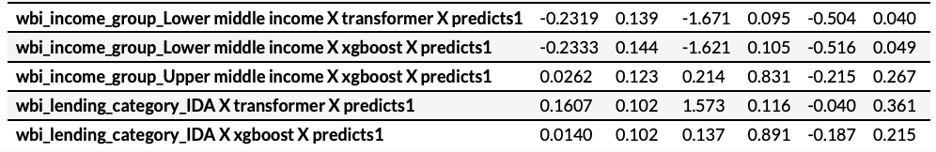
Model Creation
Model_1

Slide 13
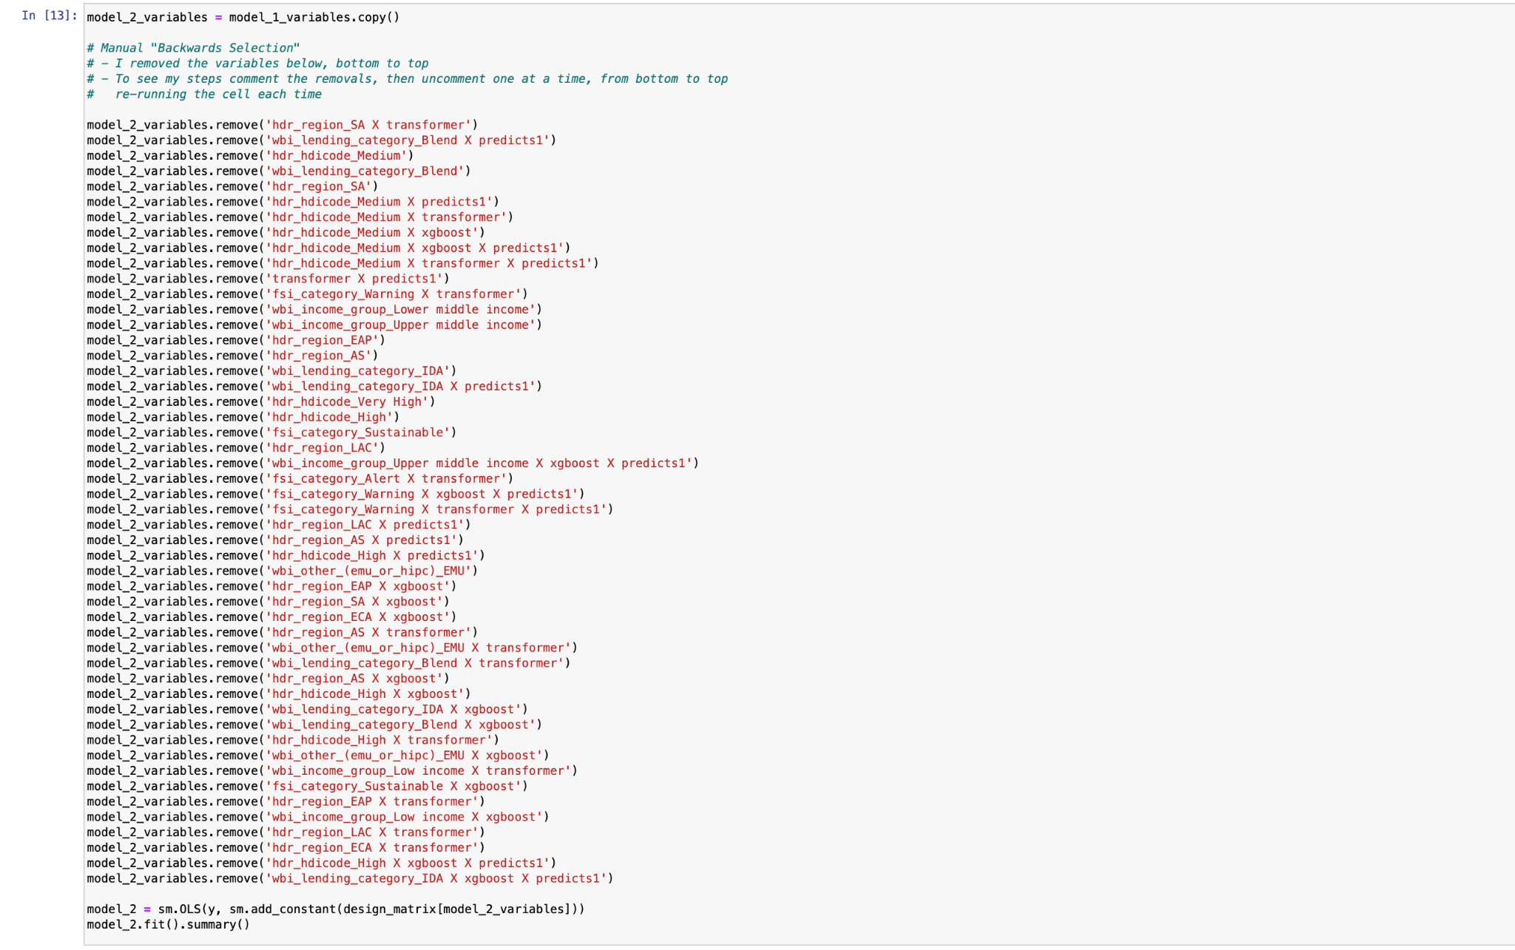
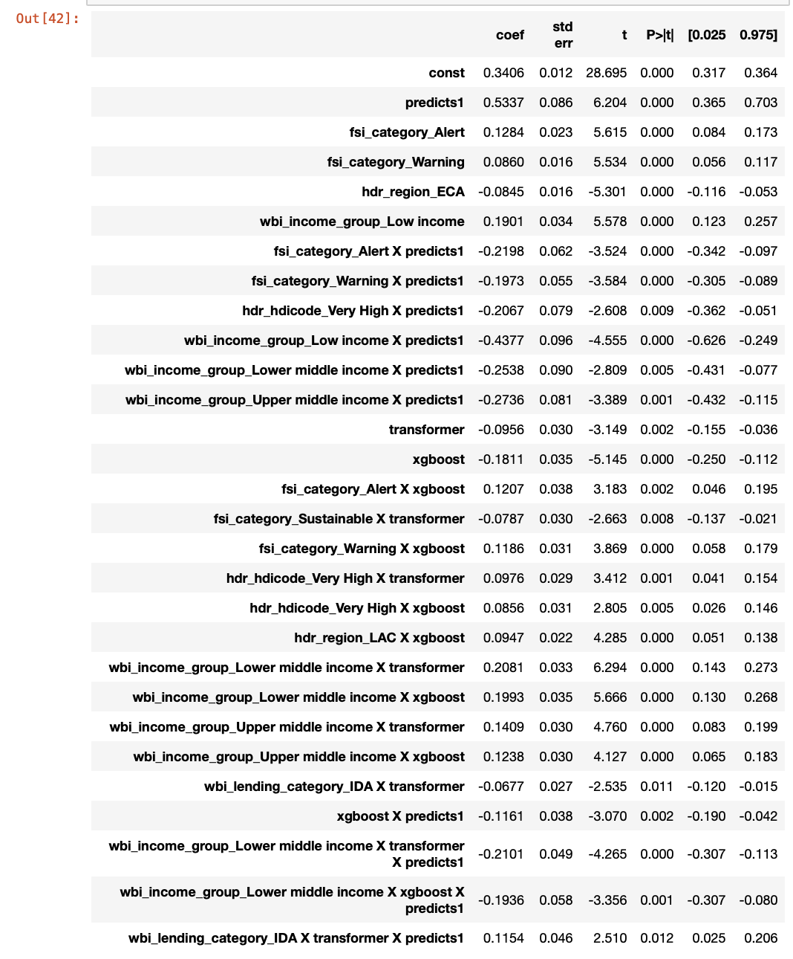
Model Creation
Model_2

Slide 14
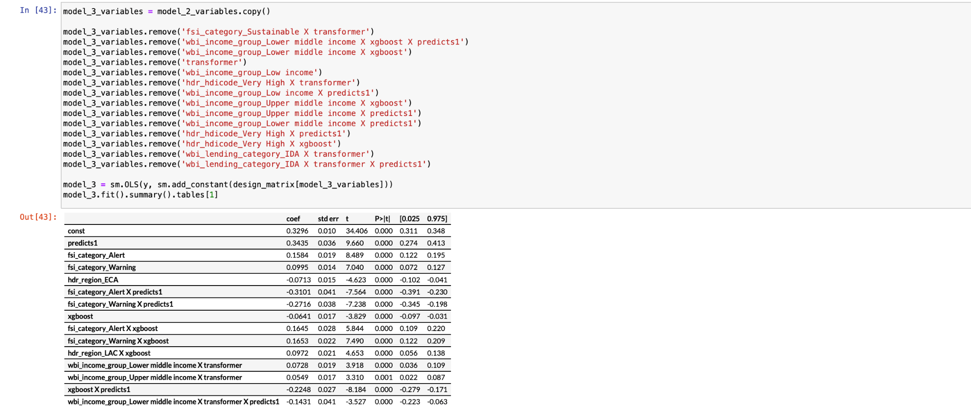
Model Creation
Model_3

Slide 15
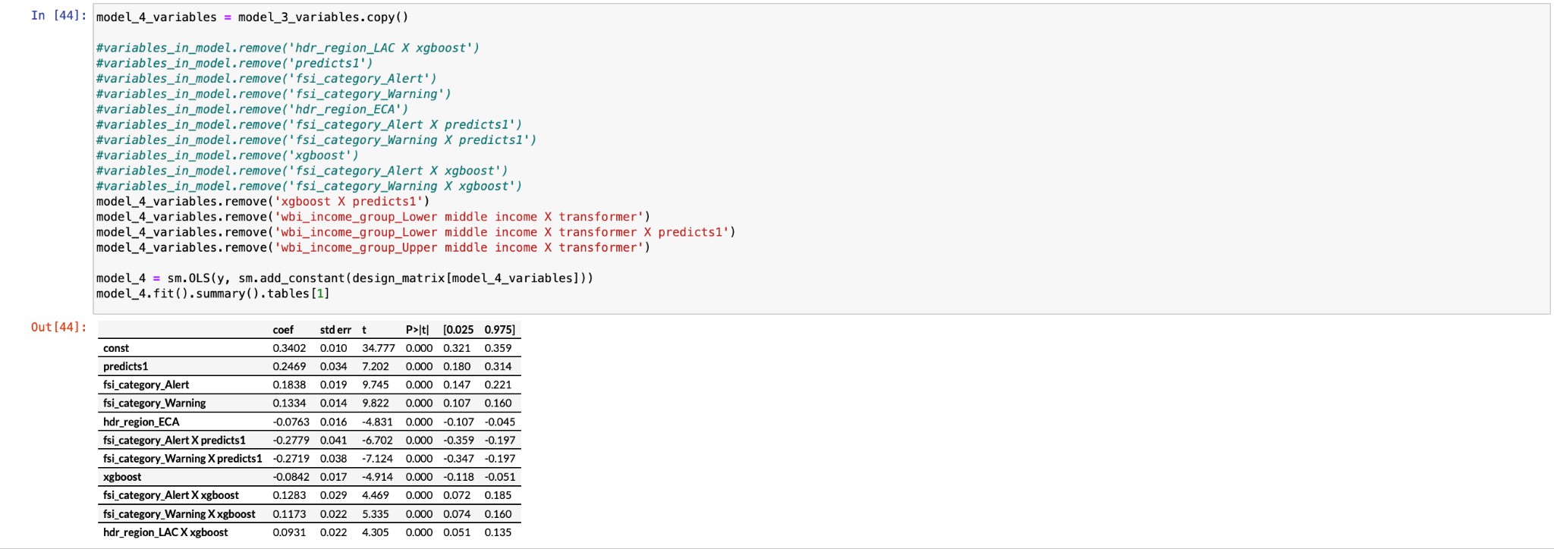
Model Creation
Model_4

Slide 16
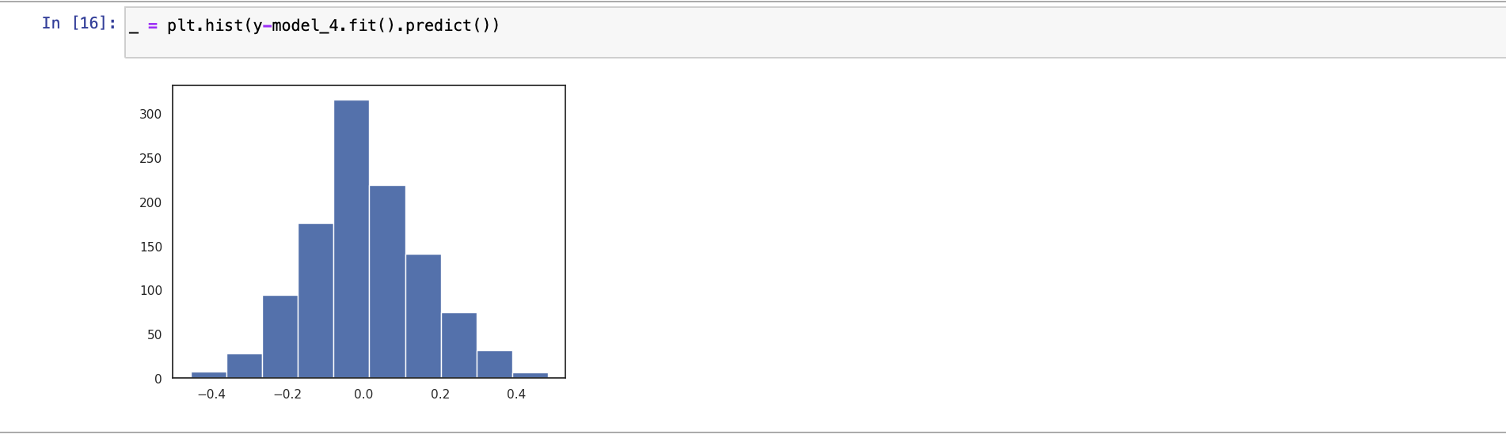
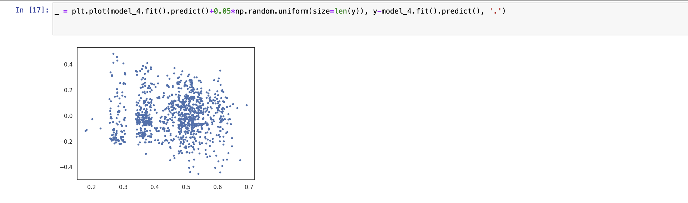
Visualization of Model 4

Slide 17
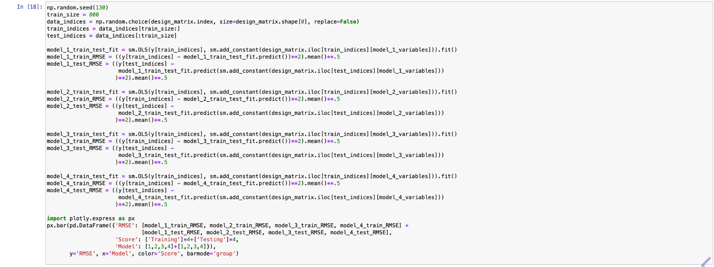
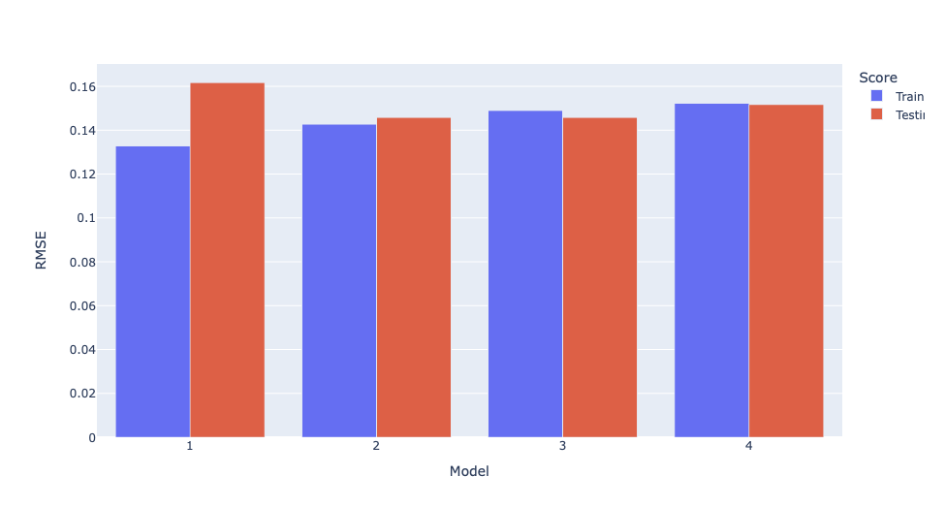
Comparing Testing and Training Scores

Slide 18
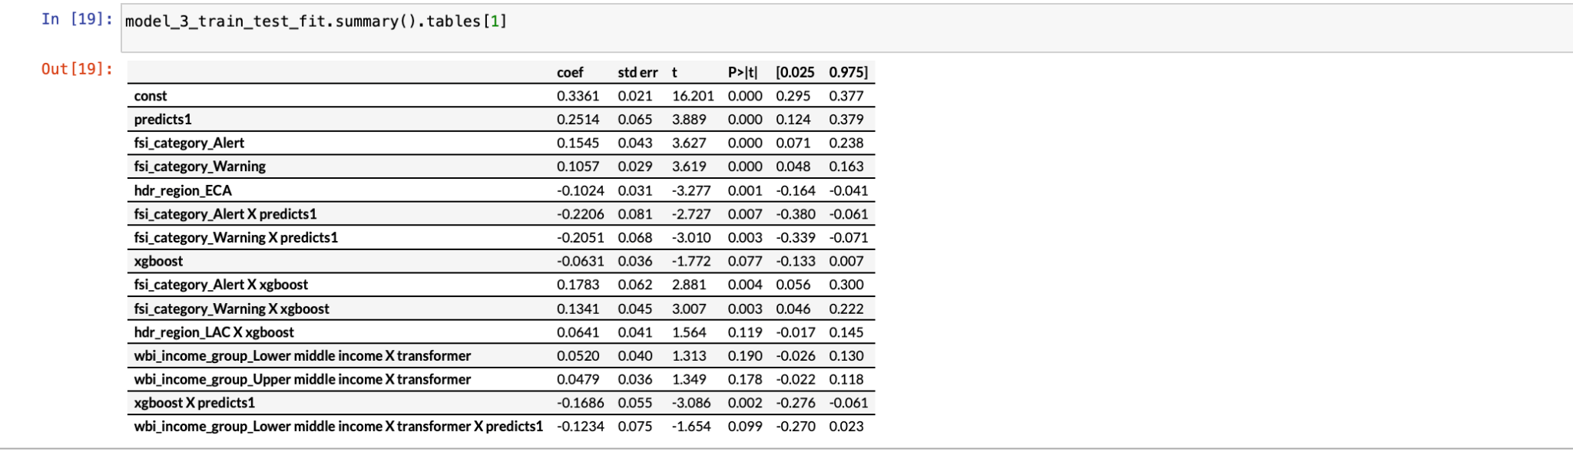
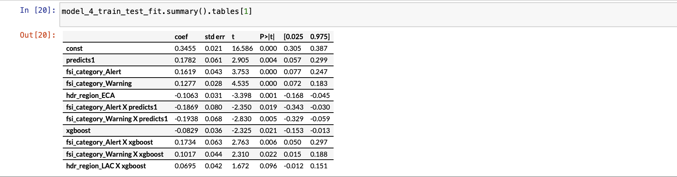
Model_3 and 4 testing data

Slide 19
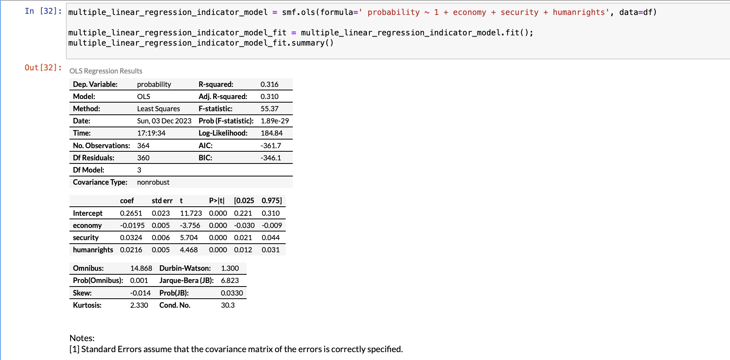
Model_5
Final Model Creation

Slide 20
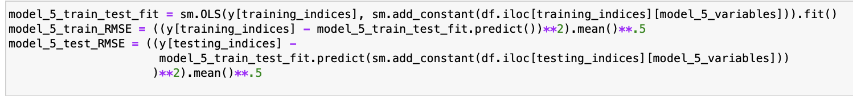
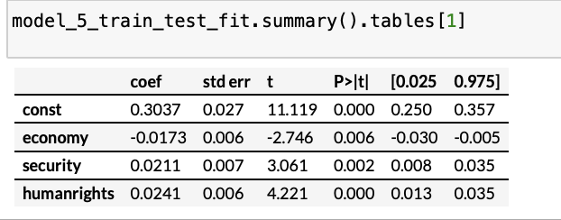
Model_5 training data and testing data
Final Model Creation

Slide 21
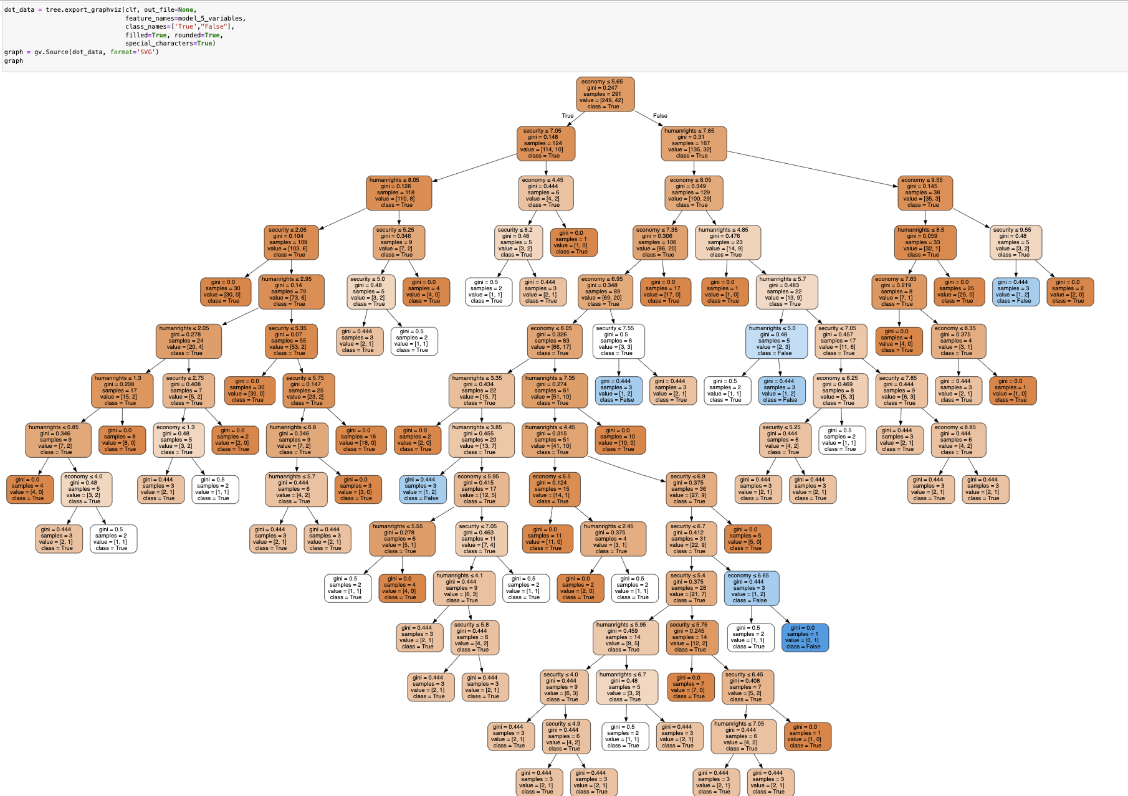
Final Classification Tree

Slide 22
Conclusion
In conclusion, the multifaceted approach centered around predictive modeling, advocacy for human rights, targeted interventions during economic upheavals, collaborative efforts with governments, and continual monitoring stands as a robust strategy for UNICEF to navigate and mitigate the impact of societal conflicts on vulnerable communities worldwide. By harnessing predictive modeling to strategically allocate resources and identify potential escalation risks, coupled with fervent advocacy for human rights and targeted interventions during economic downturns, UNICEF can proactively address conflict probabilities. Collaborating with governments to bolster security measures further fortifies the protective shield for communities. A commitment to continuous monitoring and adaptive strategies ensures sustained relevance and efficacy in navigating complex socio-economic landscapes, ultimately empowering UNICEF in its mission to safeguard the rights and well-being of children globally.

Slide 23


Slide 24
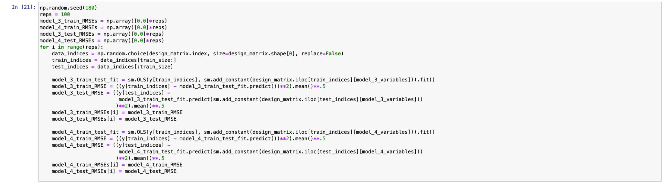
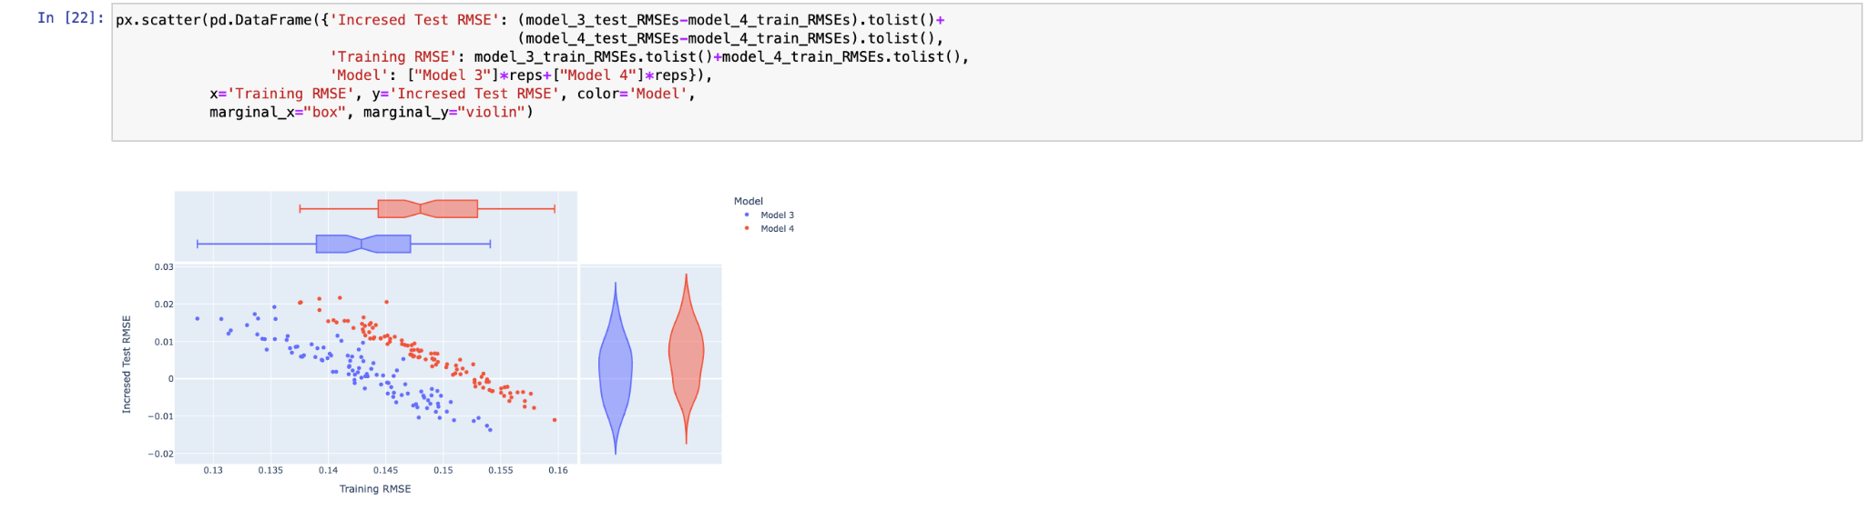
Compare model_3 and 4

Slide 25
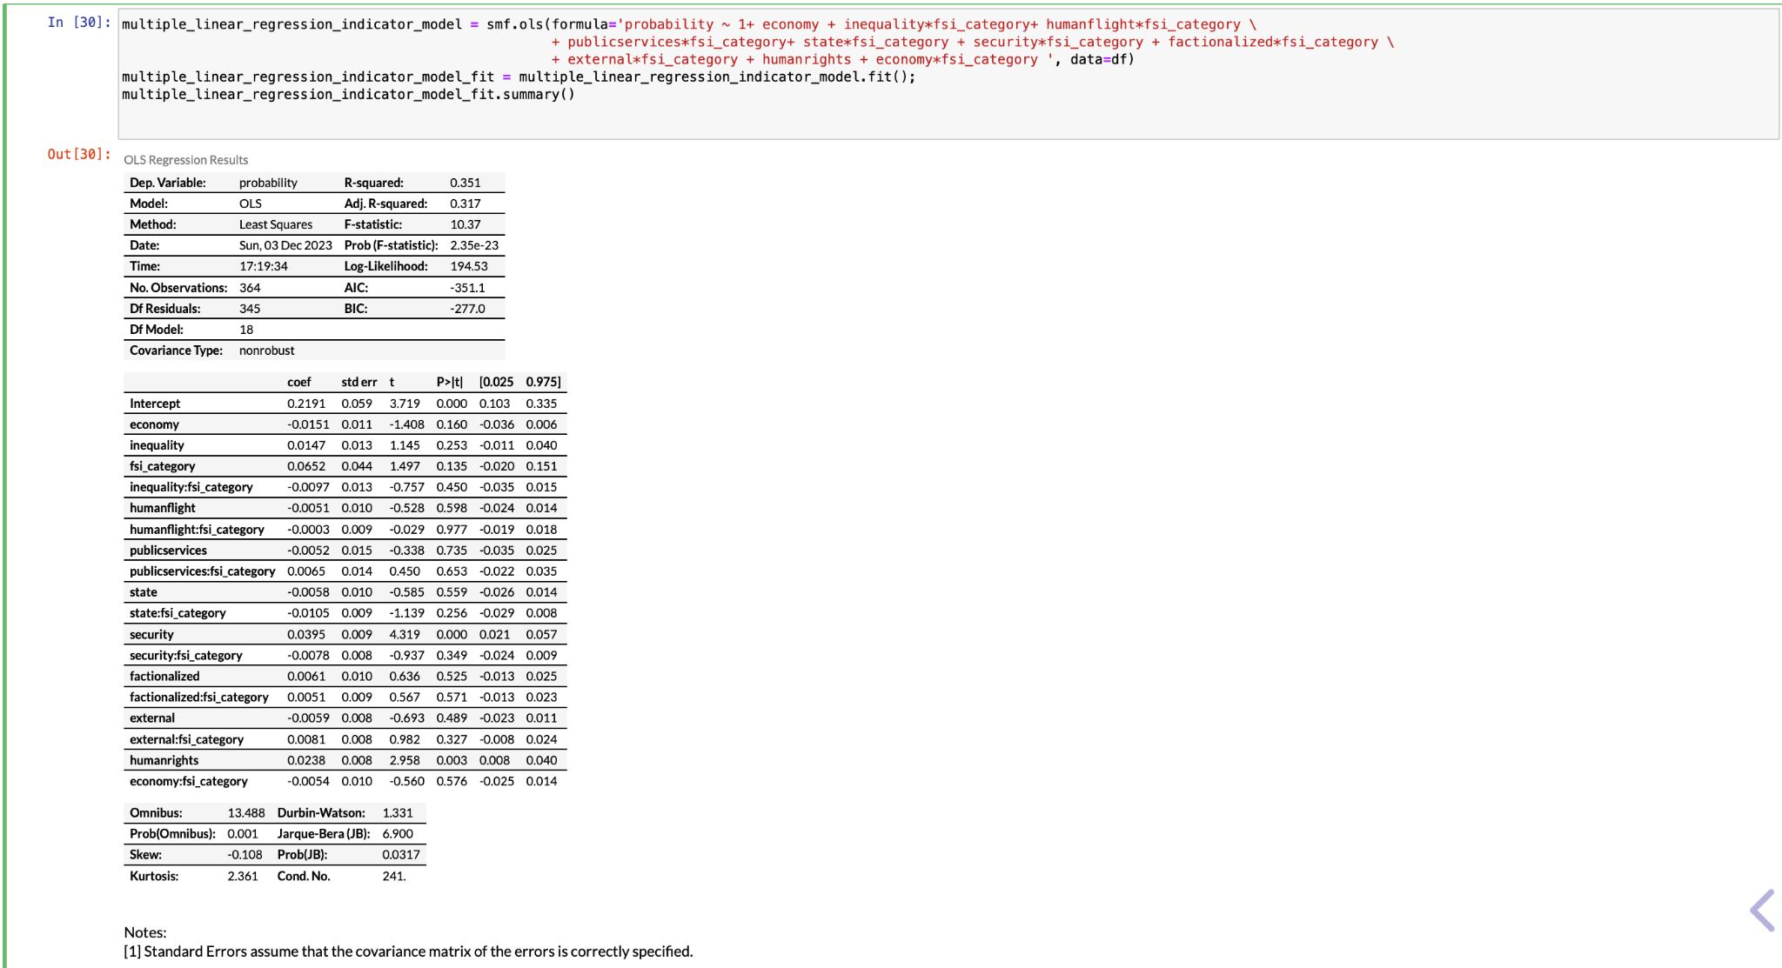
Model_5 in progressing…

Slide 26
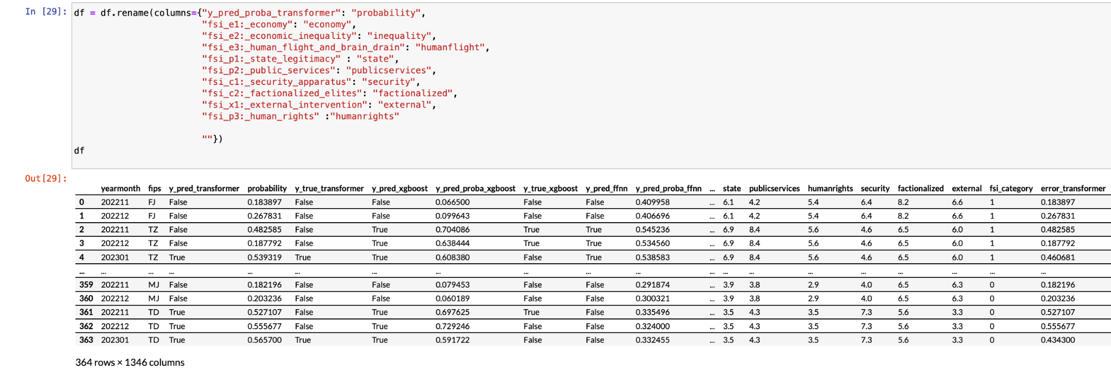
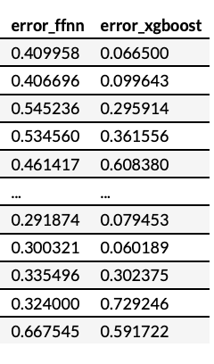
Rename the columns

Slide 27
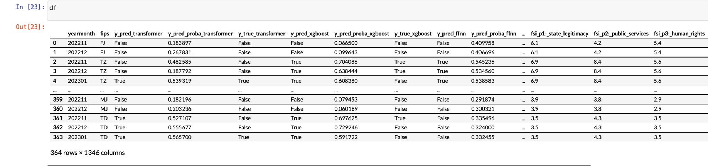
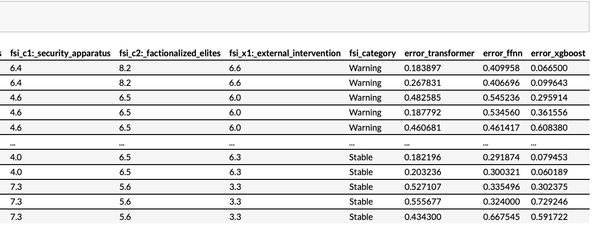
Data with error of different models

Slide 28
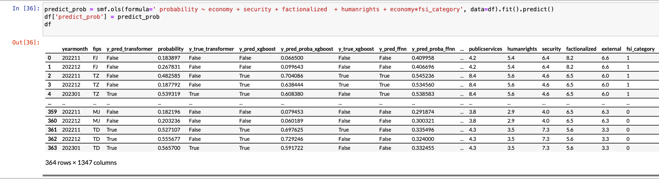
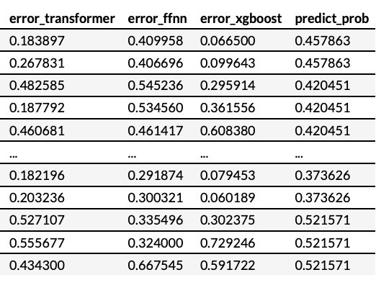
Predict

Slide 29
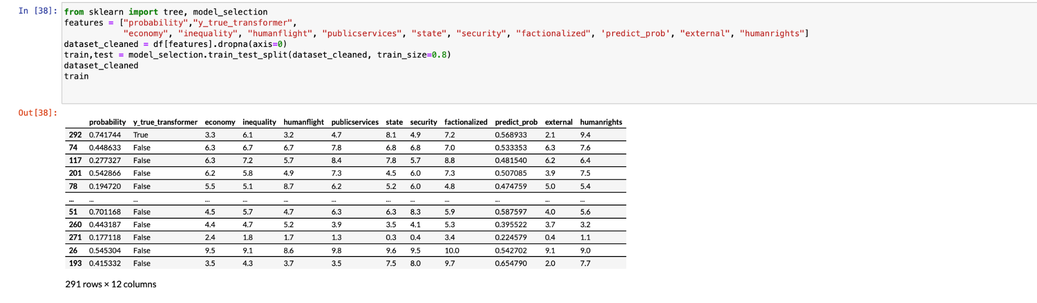
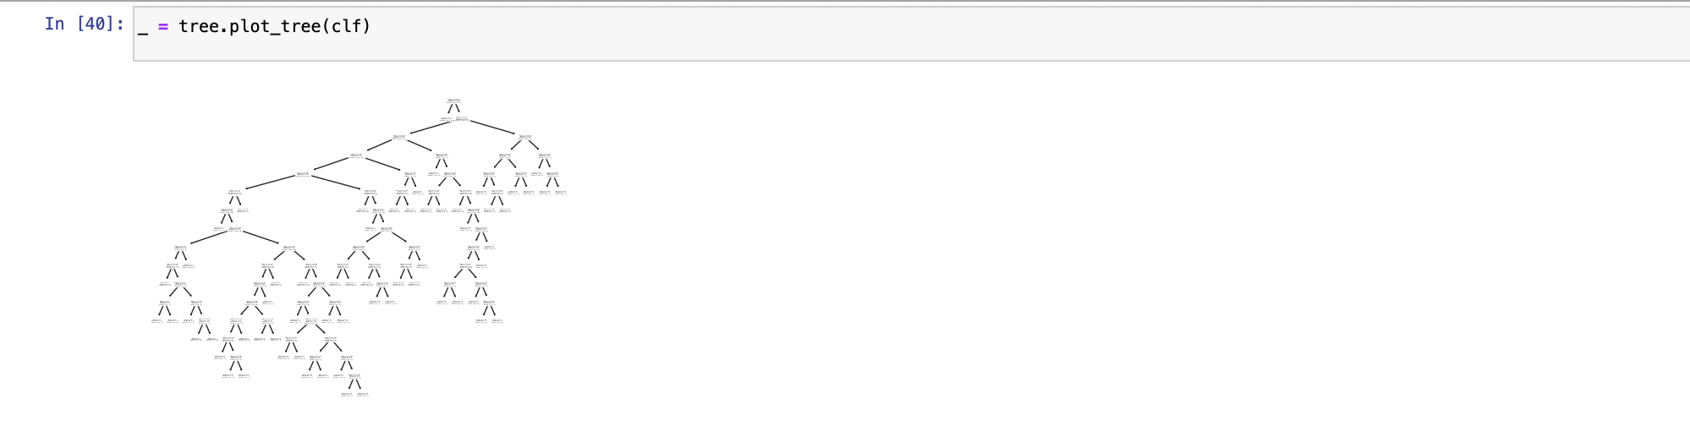
Building Classification Tree

